Slide 1
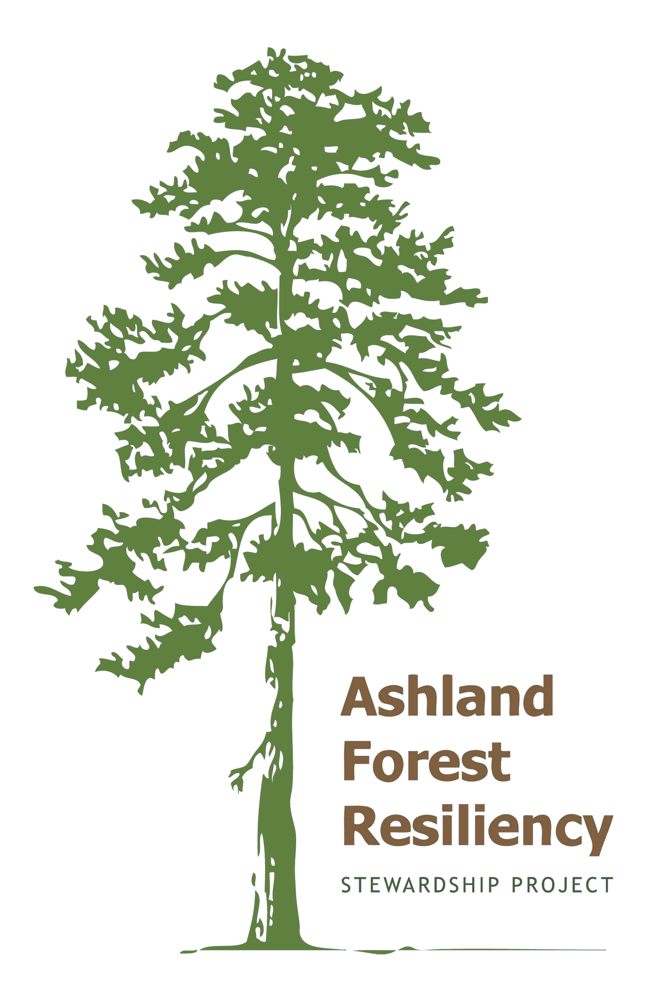
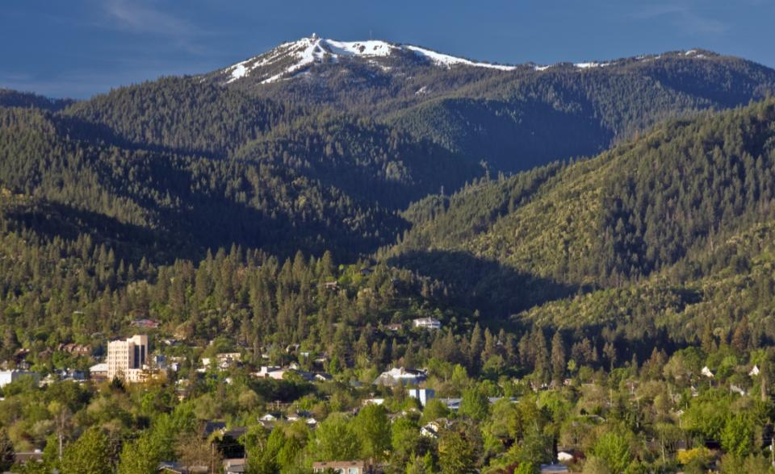
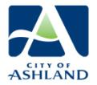
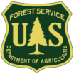
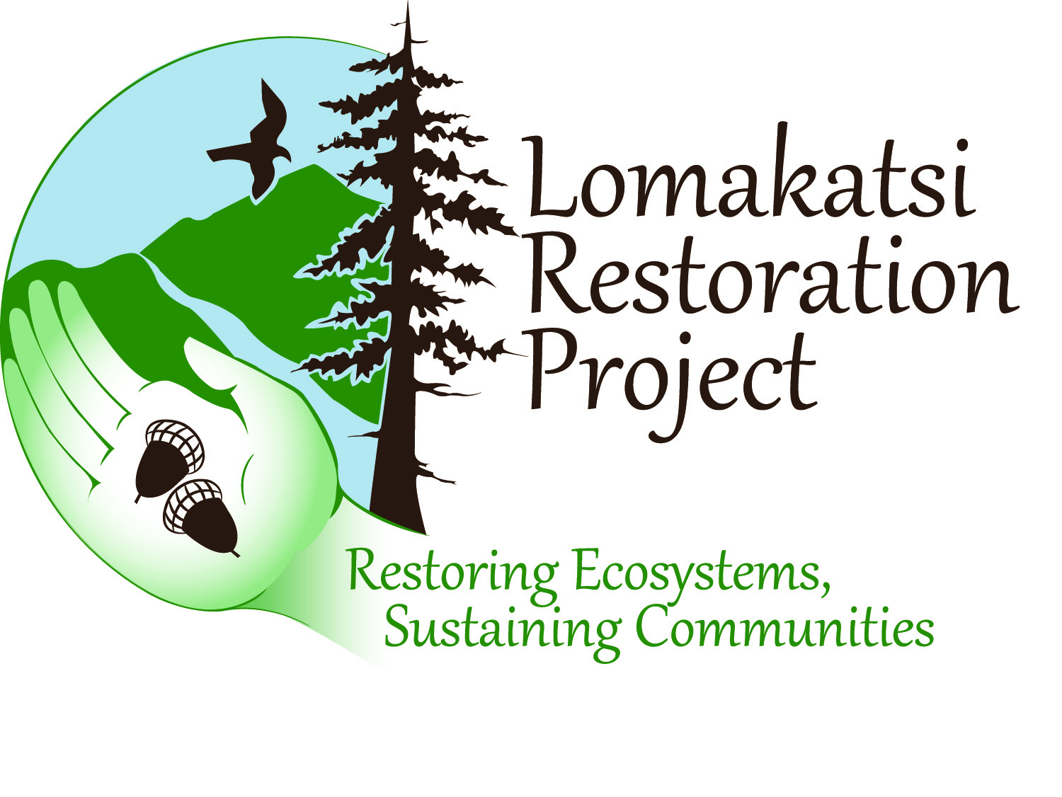
Ashland Forest Resiliency Stewardship Project
Siskiyou Mountains Ranger District
Rogue River-Siskiyou National Forest
Si

Slide 2
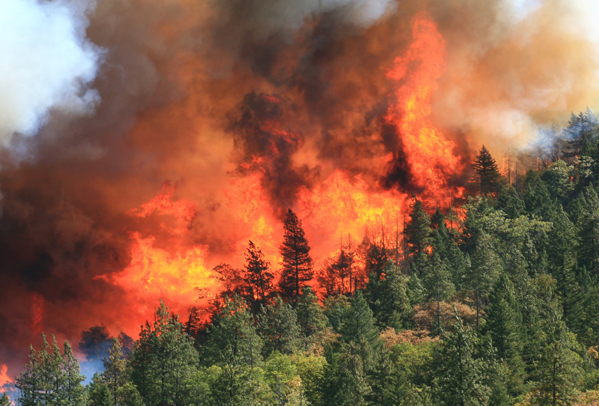
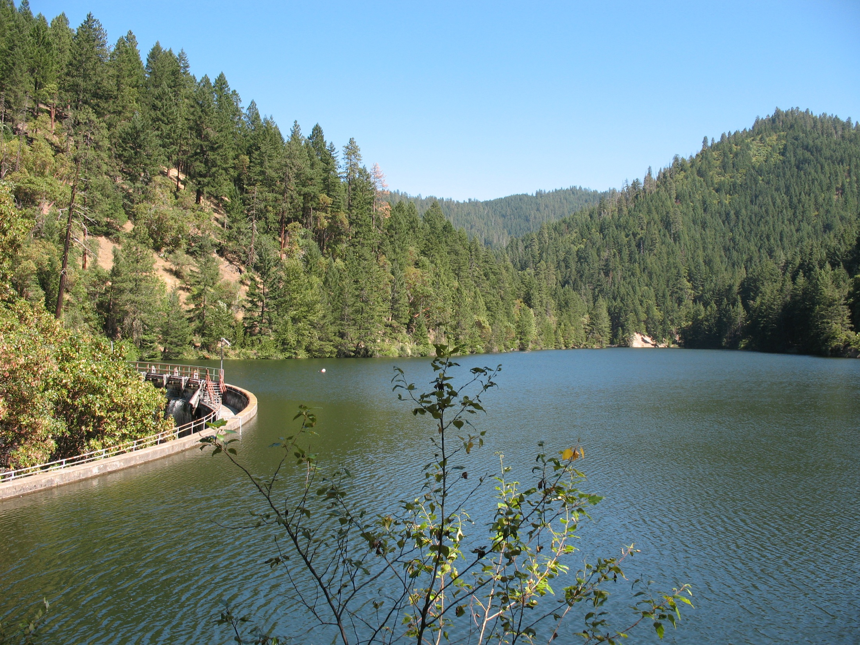
What is AFR?
A 10-year stewardship project to reduce the risk of severe wildfire in the municipal watershed and to protect water quality, older forests, wildlife, people, property and
quality of life.

Slide 3
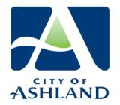
Ashland Forest Resiliency
Master Stewardship Agreement
Funding, Project Design, Oversight
Technical Expertise Community Engagement
Contracting, Workforce Training
Multi-Party Monitoring, Fiscal Sponsor

Slide 4
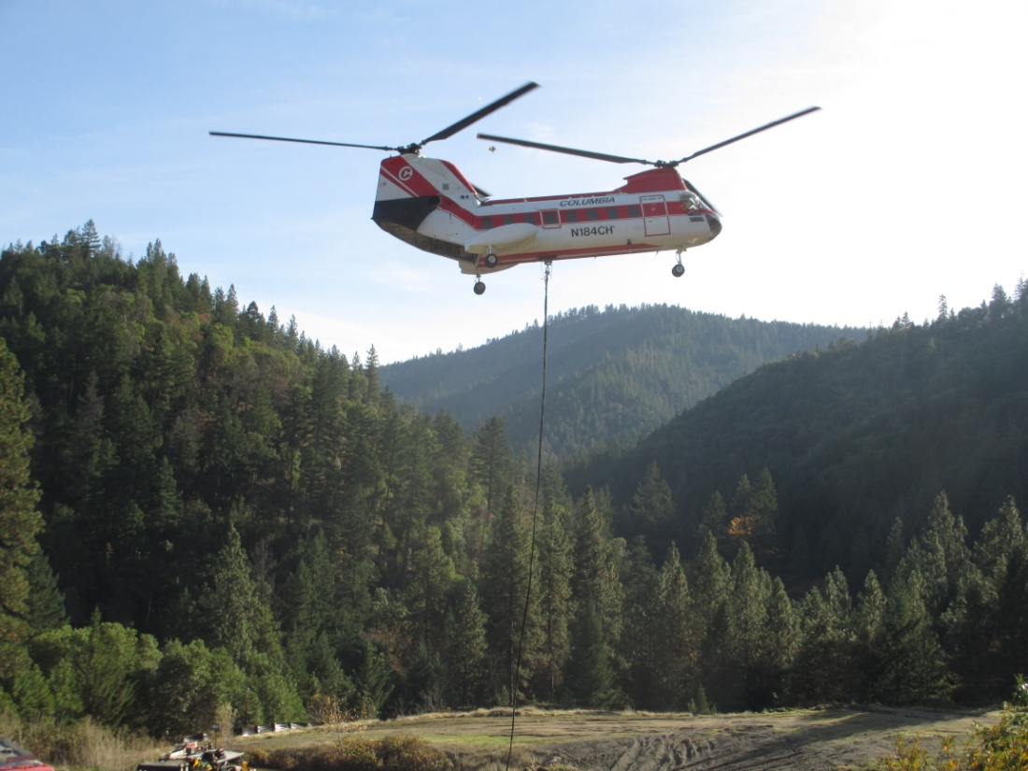
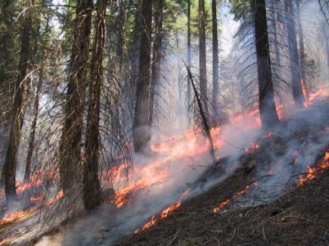
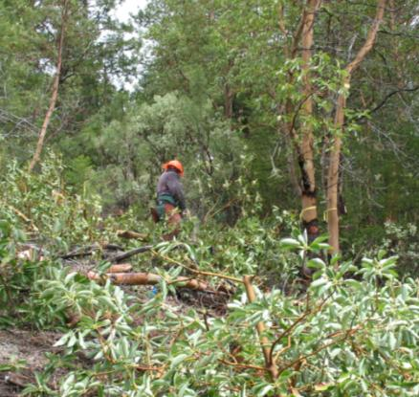
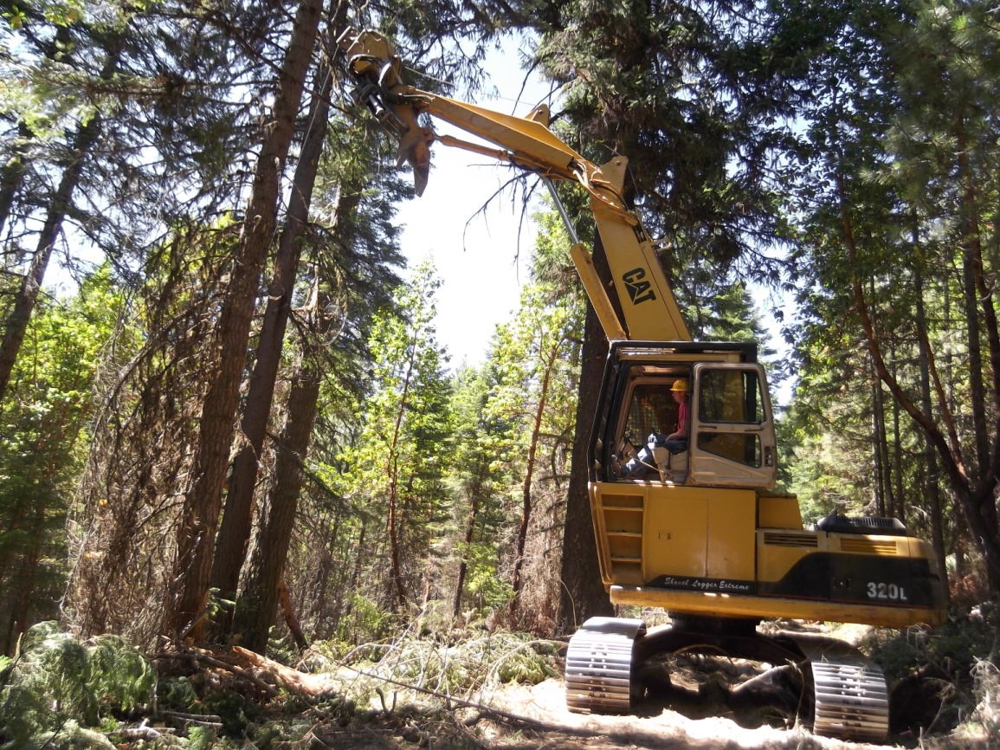
Active Stewardship
Prescribed Underburning
Density Management
7,600 Acres
over 10 years
Understory Fuel Treatments

Slide 5
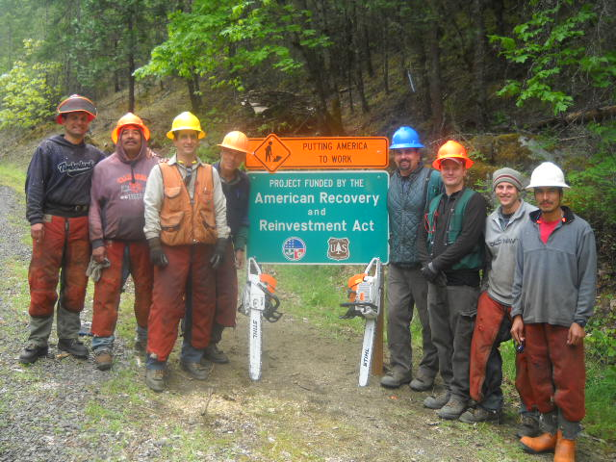
AFR and ARRA: Creating Jobs

Slide 6
Stewardship Organization
Partnership Board
Monitoring
TNC
Implementation
FS, COA, LRP
Community Engagement
COA
FS + FWS Interdisciplinary Team
Advisory Committee
Subcommittees
Project Review Process
Implementation Review Team
Effectiveness Monitoring
Public Review

Slide 7
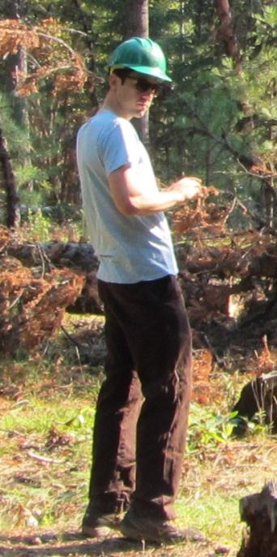
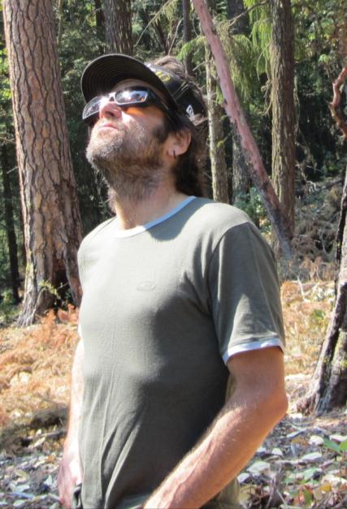
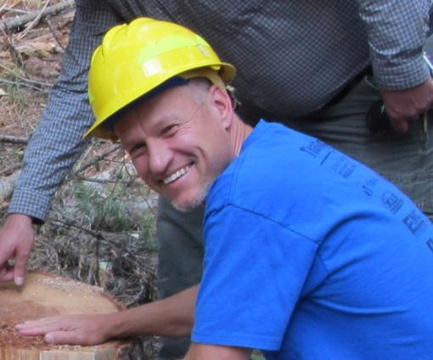
Implementation Review Team
i
Southern Oregon Forest Restoration Collaborative

Slide 8
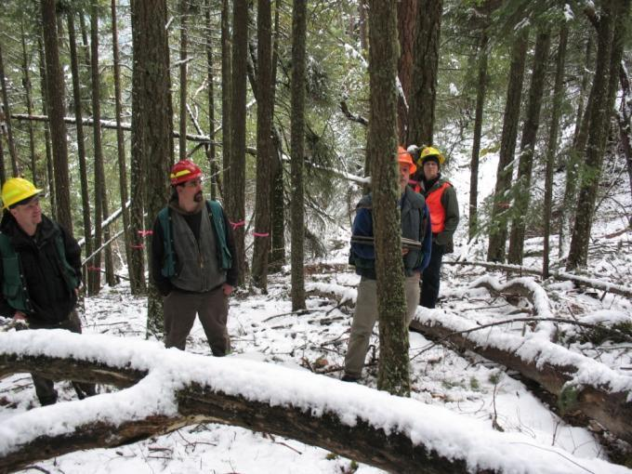
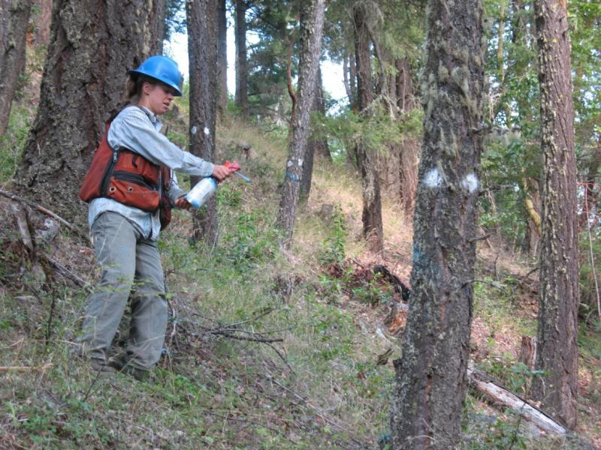
Ashland Forest Resiliency Stewardship Project
Prescriptions and plans prepared on 2,900 acres
Marking and cruising on 694 acres
Notes:
Lower left : Katie Schubert marking cut trees

Slide 9
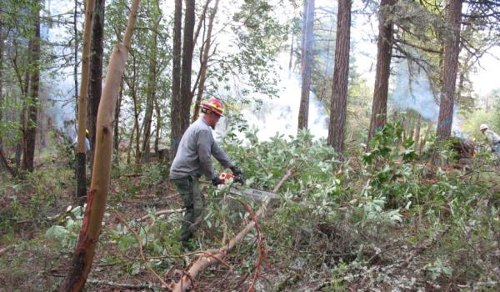
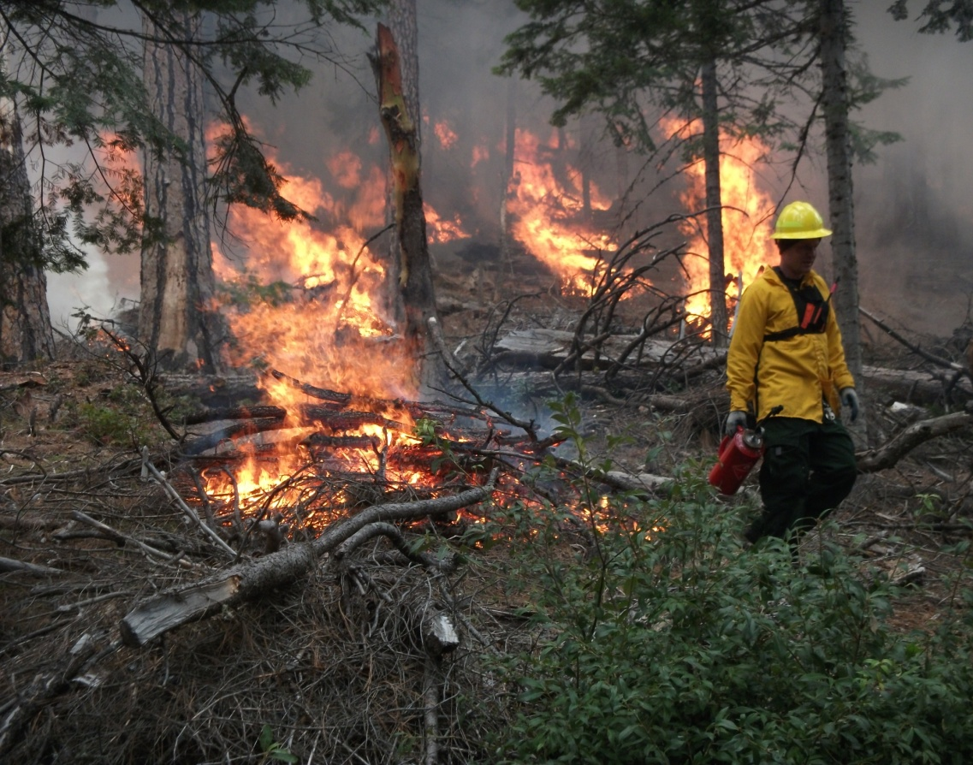
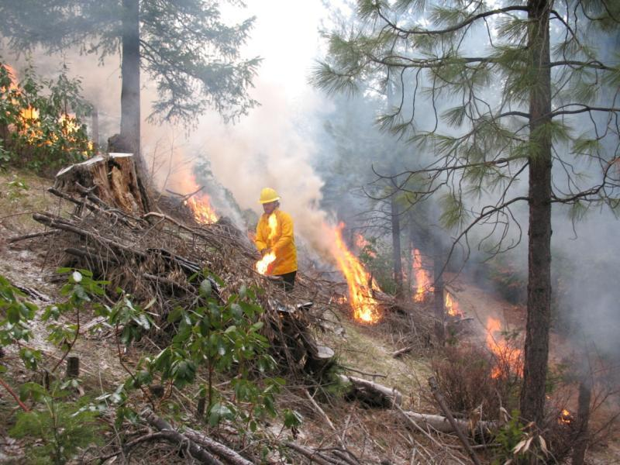
Ashland Forest Resiliency Stewardship Project
Fuels mitigation completed
on over 3,200 acres
Notes:
Lower left: Erin Halcomb and Joni Brazier discuss soil compaction
Right: Guenther Castillon discusses prescriptions with the AFR Partners

Slide 10
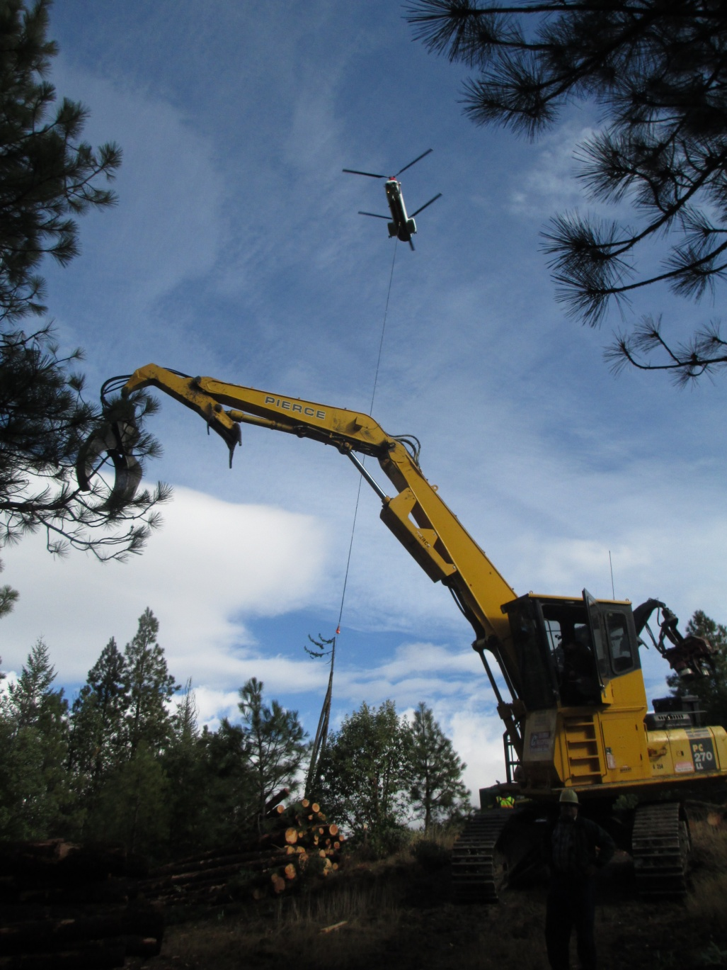
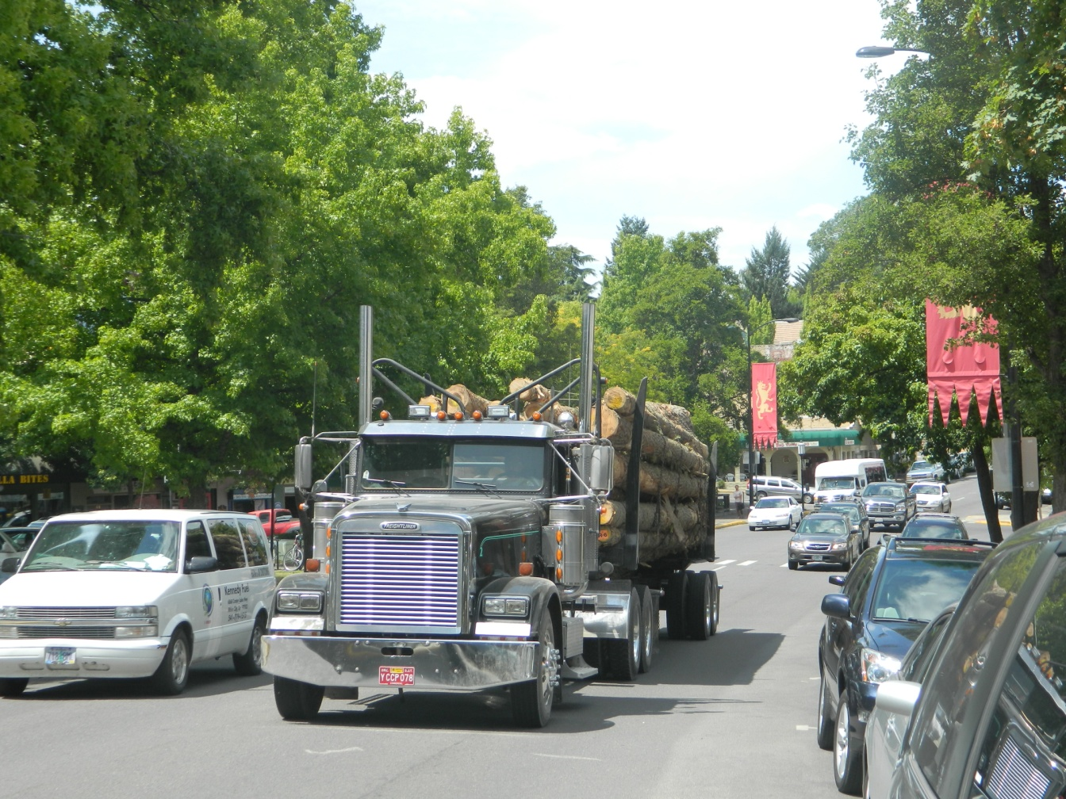
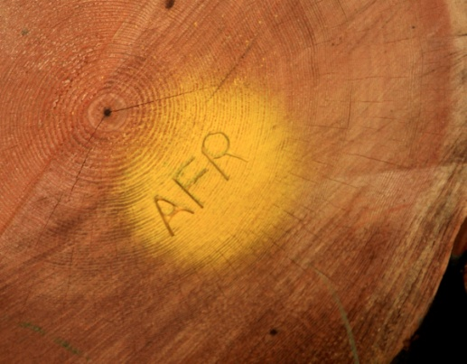
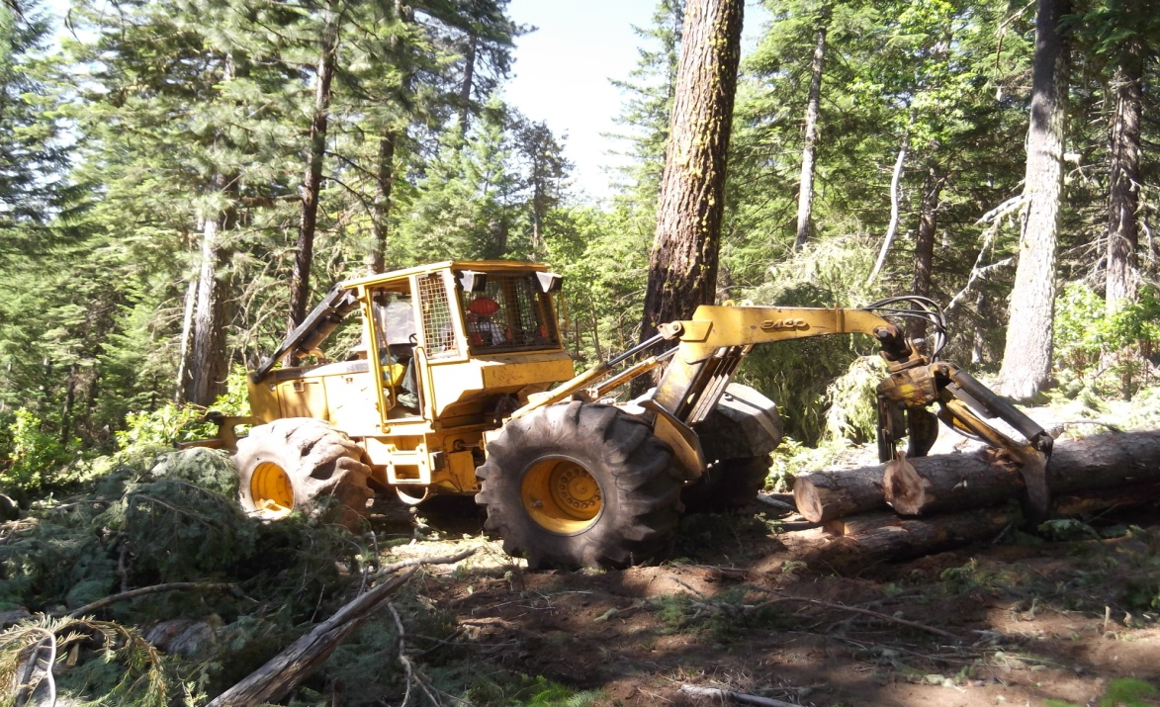
355 acres helicopter thinning
Ashland Forest Resiliency Stewardship Project
344 acres ground-based thinning
2.2 million board feet of wood trucked to local mills

Slide 11
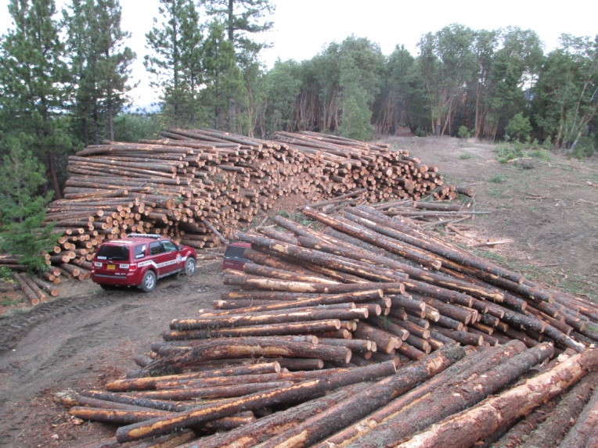
AFR Partnership
project management
Klamath Tribal Workforce
Lomakatsi
Workforce
Forest Energy Group
Columbia
Helicopters
AFR
Workforce
Hilltop Logging
Grayback
Forestry
High Sierra Enterprises
RB Brown Trucking
Youth Employment Programs
JD Forestry
High Country Timber

Slide 12
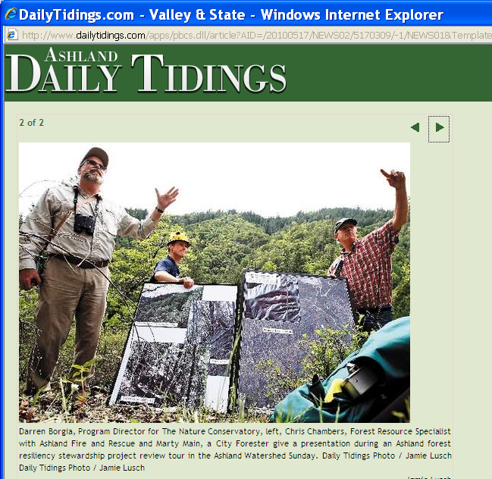
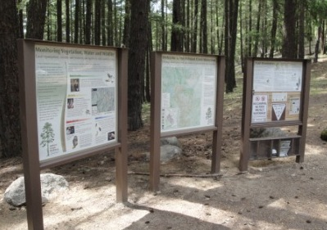
AFR Community Engagement
45 events and tours
AFR website, Facebook
Local media
Interpretive Signage

Slide 13
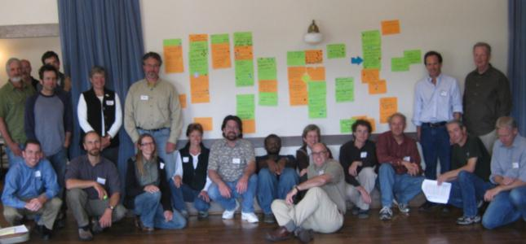
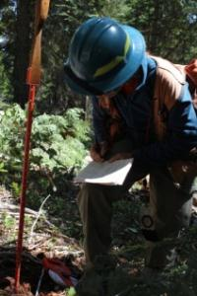
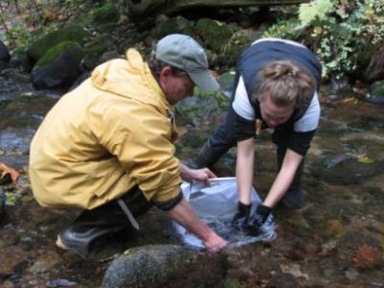
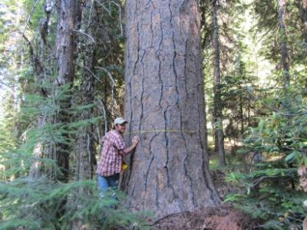
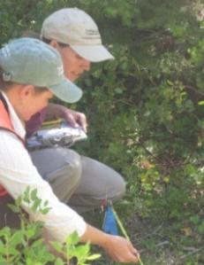
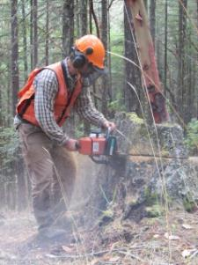
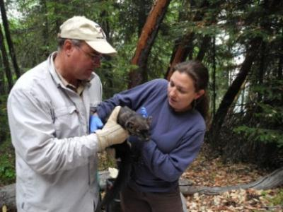
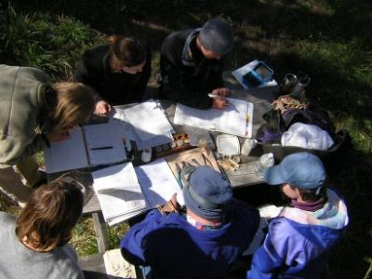
Multiparty Monitoring Ashland Forest Resiliency Partnership
Stakeholder Driven Plan
Soils
Large Tree Retention and Survival
Water Quality and Aquatic Habitat
Late Successional Wildlife Habitat
Herbaceous Recovery
Fire Histories
Birds as Indicators

Slide 14
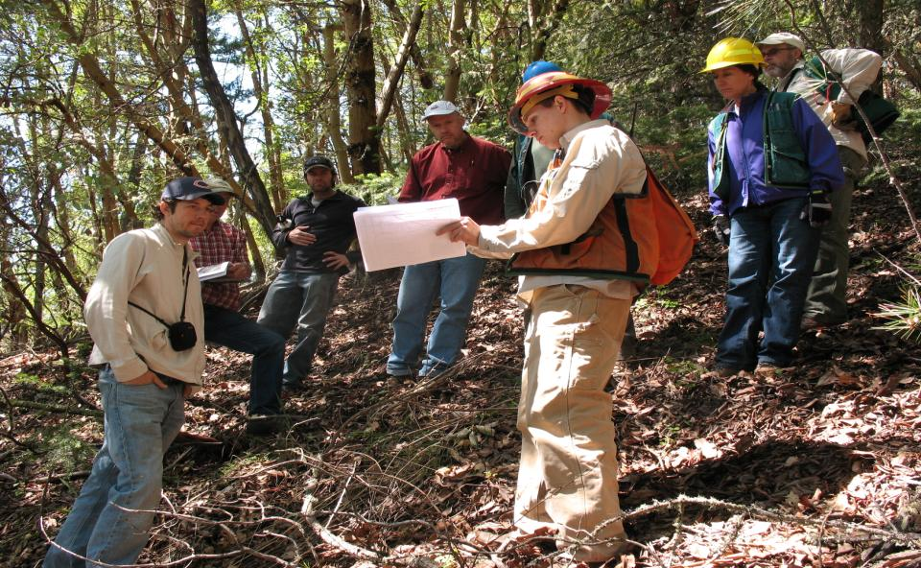
Multi-Party
Monitoring
"They are doing what we want to see — thinning small-diameter trees and leaving the legacy trees," he said. "And they are getting out a byproduct.”-Joseph Vaile (KS Wild) in Medford Mail Tribune
Implementation Review Team

Slide 15
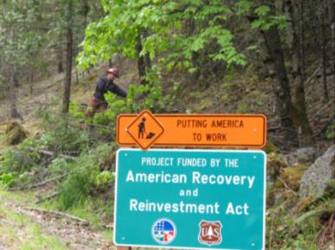
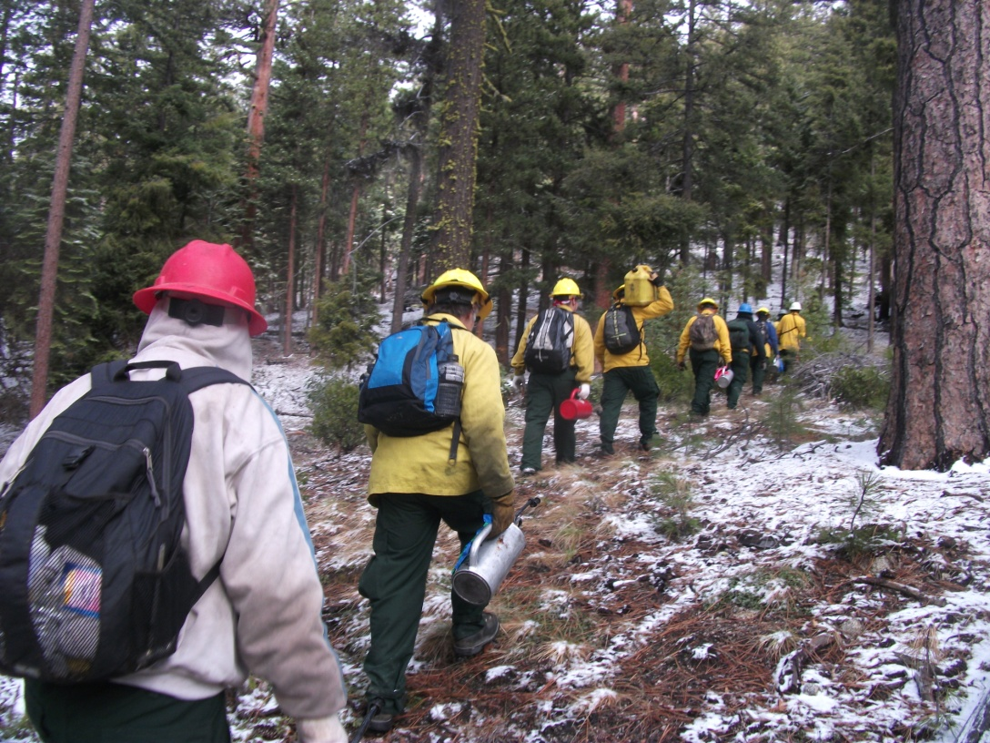
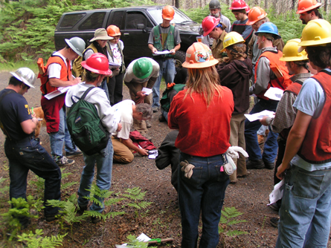
AFR Job Training and Employment
Ecological Workforce Training

Slide 16
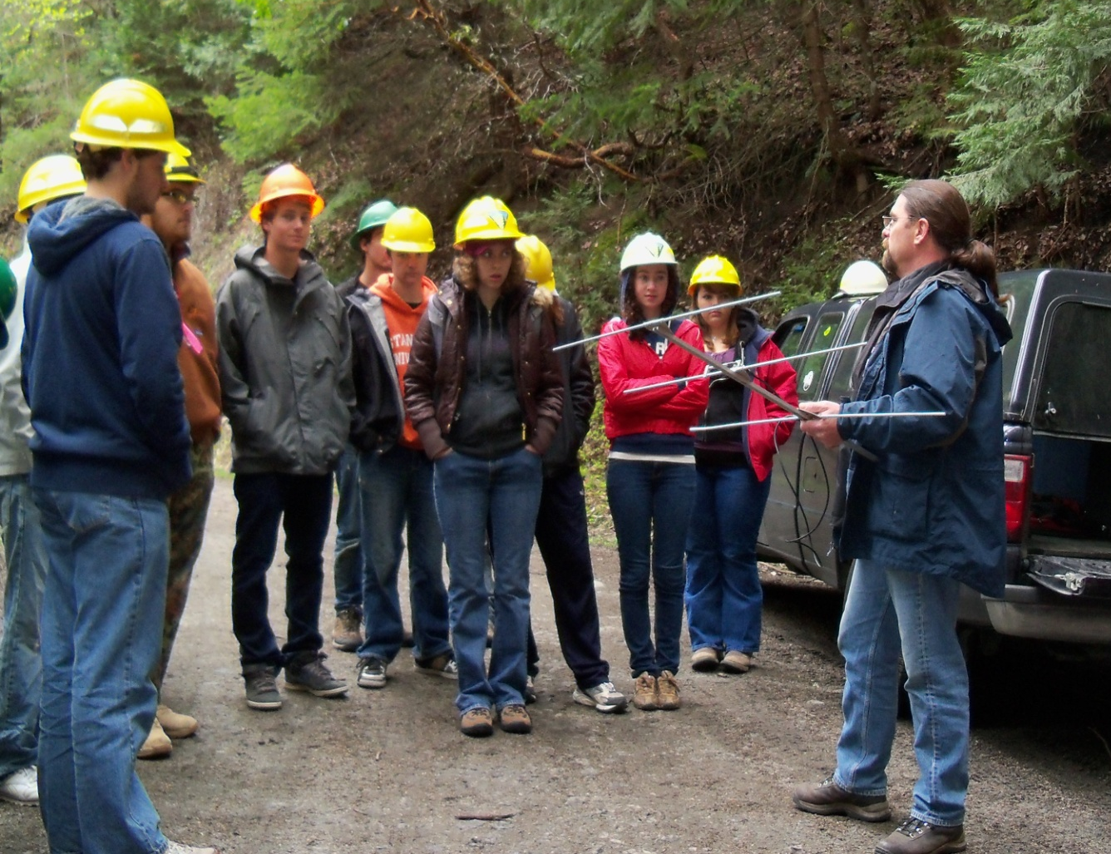
AFR Youth Engagement
Kids in the Watershed
1,927 children instructed during 5,328
hours of classroom and field sessions

Slide 17
Work Remains
Current ARRA funds spent by
September 2013.
1.2 million dollars in timber
receipts for federal FY 2014
Roughly ½ of the work will be
completed with current funds
Estimate 4 million dollars to
complete our goal of 7600 acres

Slide 18
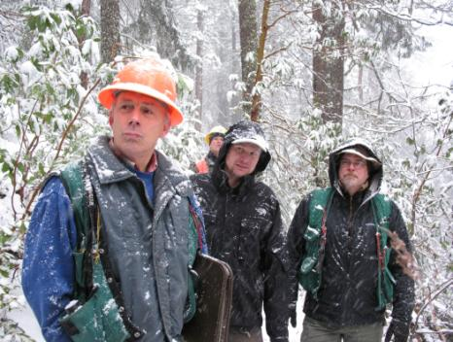
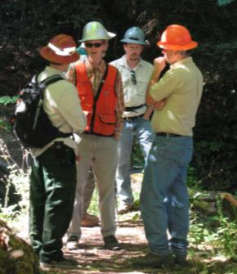
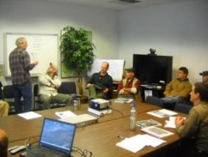
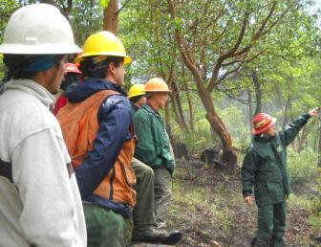
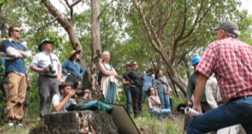
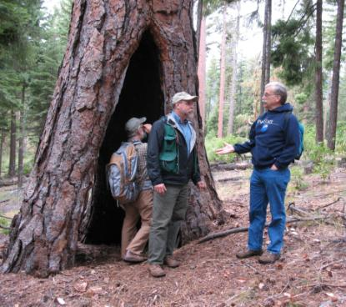
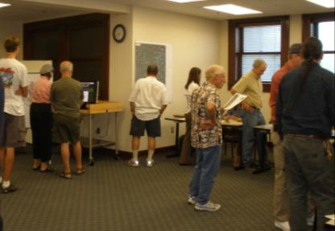
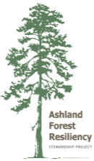
Thank You
www.ashlandwatershed.org

