Slide 1
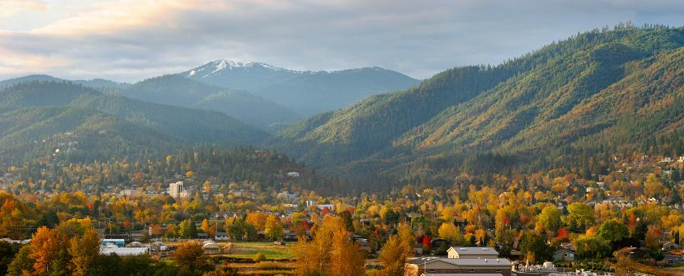
Housing and Human Services Advisory Committee
Annual Update to the Council
February 06, 2023
Notes:
Ashland has been intentional in the way it has charted a deliberate plan for addressing growth and change
40+ years

Slide 2
Transition to in person meetings
Despite the pandemic freeze on unnecessary meetings, the Housing and Human Services Commission did continue to meet regularly throughout the pandemic, and no meetings were missed in 2022.
The Commission resumed meeting in person in October 2022.
Notes:
Ashland has been intentional in the way it has charted a deliberate plan for addressing growth and change
40+ years

Slide 3
Housing Production Strategy
Two members of the HHSAC served as representatives on the Housing Production Strategy Advisory Group. They attended 5 additional meetings and helped inform the development of that document.
The HHSAC had two meetings devoted to prioritization of the HPS strategies.
HHSAC undertook community engagement activities to help with the development of the priorities
Key informant interviews
Online questionnaire development
Targeted group outreach events: SOU Students, Manufactured Home parks, and rental housing developments
SOU focus group
Notes:
Ashland has been intentional in the way it has charted a deliberate plan for addressing growth and change
40+ years

Slide 4
Education and Outreach: Rent Burden Forum
Was held in August 2022
Attended by 30+ people
Panel Discussion
Overview of the Housing Production Strategy was provided
Distributed the housing production strategy questionnaire and gained feedback about strategy priorities.
Developed a Rent Burden Forum Video
4

Slide 5
Community Development Block Grant and Affordable Housing Trust Fund Review and Recommendations
Reviewed applications from 2 applicants, heard presentations and made recommendations regarding Community Development Block Grant funding.
Reviewed applications from 2 applicants, heard presentations and made recommendations regarding the remaining balance of CDBG-CARES act-pandemic related funding.
Reviewed application from 3 applicants, heard presentations and made recommendations regarding the City’s affordable housing trust funds.
Made recommendations for a total of over 400K in grant funding
Notes:
Ashland has been intentional in the way it has charted a deliberate plan for addressing growth and change
40+ years

Slide 6
Severe Weather Shelter Recommendation
The Committee formed a subcommittee in 2021 and met several times to work on drafting a policy recommendation based on research of best practices.
Held two virtual stakeholder meetings in January of 2022. Feedback from stakeholders informed the development of the recommendations.
Facilitated a debrief of recent active shelter events.
Presented to the Council twice regarding recommendations. Resolution 2022-03 was adopted in November 2022.
Committee members volunteered and organized cooling shelters due to a lack of a non-profit partner to organize shelter.
OPB Shelter Video.
Notes:
Ashland has been intentional in the way it has charted a deliberate plan for addressing growth and change
40+ years

Slide 7
Goal Setting Retreat
In 2022 the Commission met for a goal setting meeting on Dec. 9th.
The Commission identified 7 goals:
Build Cooperation and systems of communication for emergency shelter at both the executive and operational levels.
Promote Workforce Housing:
Education about the UGB expansion process
Promote capacity building and encourage new workforce housing partnerships
Work with SOU on potential housing opportunities on identified surplus properties
Increase capacity for more mobile home parks
Barrier Removal/to promote infill housing and group housing options
Food Resources-Address the need for a commercial kitchen in Ashland
Notes:
Ashland has been intentional in the way it has charted a deliberate plan for addressing growth and change
40+ years

Slide 8
QUESTIONS?
Thank you
Notes:
Ashland has been intentional in the way it has charted a deliberate plan for addressing growth and change
40+ years

